Slide 1


DATA SCIENCE EL-334 BSIT
LECTURE # 04
Data manipulation and Cleaning
Python Pandas: A Data Science Library
by
Safoora Qurban

Slide 2

Python Pandas: A Data Science Library

Slide 3
What is pandas?
• Opened sourced in 2009, pandas is a library containing high-level data structures and tools that have been created to assist a Python programmer to perform powerful data manipulations, and discover information in that data in a simple and fast way.
• The simple and effective data analysis requires the ability to index, retrieve, tidy, reshape, combine, slice, and perform various analyses on both single and multidimensional data, including heterogeneous typed data that is automatically aligned along index labels.

Slide 4
Why pandas is important?
To enable these capabilities, pandas provides the following features:
• High performance array and table structures for representation of homogenous and heterogeneous data sets: the Series and DataFrame objects
• Flexible reshaping of data structure, allowing the ability to insert and delete both rows and columns of tabular data
• Hierarchical indexing of data along multiple axes (both rows and columns), allowing multiple labels per data item
• Labeling of series and tabular data to facilitate indexing
• Ability to easily identify and fix missing data, both in floating point and as non-floating point formats

Slide 5
Why pandas is important?
To enable these capabilities, pandas provides the following features:
• Powerful grouping capabilities and a functionality to perform split-apply-combine operations on series and tabular data
• Simple conversion from ragged and differently indexed data of both NumPy and Python data structures to pandas objects
• Smart label-based slicing and subsetting of data sets, including intuitive and flexible merging, and joining of data with SQL-like constructs
• Extensive I/O facilities to load and save data from multiple formats including CSV, Excel, JSON and others.

Slide 6
Why pandas is important?
To enable these capabilities, pandas provides the following features:
• Explicit support for time series-specific functionality, providing functionality for date range generation, moving window statistics, time shifting, lagging, and so on
• Built-in support to retrieve and automatically parse data from various
web-based data sources such as Yahoo!, Google Finance, the World Bank,
and several others

Slide 7
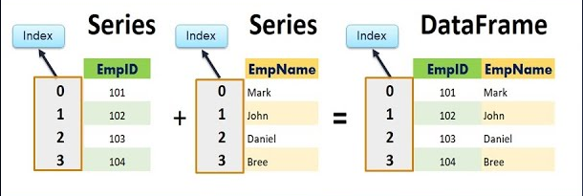
Primary pandas objects
There are two primary objects provided by the pandas framework: Series and DataFrame.
The DataFrame objects will be the most frequently used as they provide the means to manipulate tabular and heterogeneous data.

Slide 8
The pandas Series object
The Series is the primary building block of pandas.
A Series represents a one-dimensional labeled indexed array based on the NumPy ndarray.
A pandas Series deviates from NumPy arrays by adding an associated set of labels that are used to index and efficiently access the elements of the array by the label values instead of just by the integer position.
This labeled index is a key feature of pandas Series (and, as we will see, also a DataFrame) and adds significant power for accessing the elements of the Series over a NumPy array

Slide 9
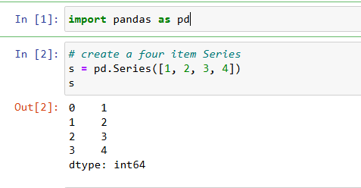
Creating Series object
A Series can be created and initialized by passing either a scalar value, a NumPy ndarray, a Python list, or a Python Dict as the data parameter of the Series constructor. This is the default parameter and does not need to be specified if it is the first item.
This has created a pandas Series from the list. Notice that printing the series resulted in what appears to be two columns of data. The first column in the output is not a column of the Series object, but the index labels. The second column is the values of the Series object. Each row represents the index label and the value for that label. This Series was created without specifying an index, so pandas automatically creates indexes starting at zero and increasing by one.

Slide 10
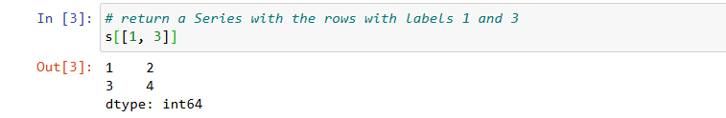
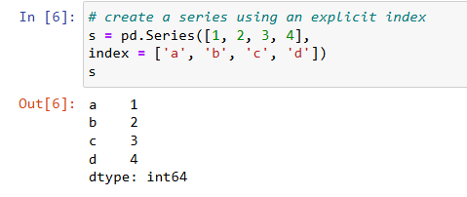
The pandas Series object (cont.)
Elements of a Series object can be accessed through the index using []. This informs the Series which value to return given one or more index values.
A Series object can be created with a user-defined index by specifying the labels for the index using the index parameter.

Slide 11
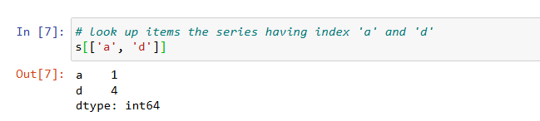
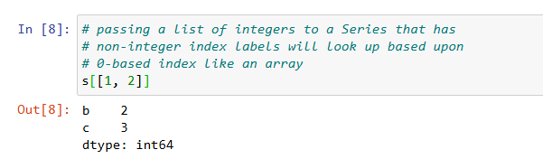
The pandas Series object (cont.)
Data in the Series object can now be accessed by alphanumeric index labels by passing a list of the desired labels, as the following demonstrates
It is still possible to refer to the elements of the Series object by their numerical position

Slide 12
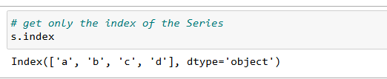
The pandas Series object (cont.)
The s.index property allows direct access to the index of the Series object.
The index is itself actually a pandas object. This shows us the values of the index and that the data type of each label in the index is object

Slide 13
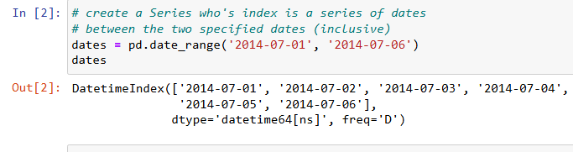
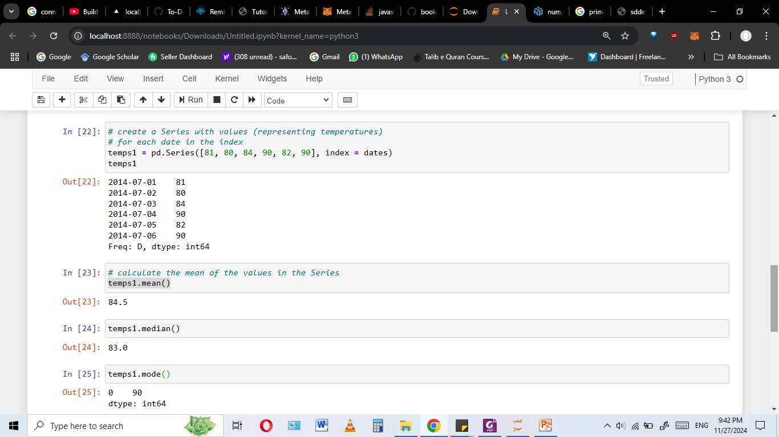
Creating date range in pandas
A common usage of a Series in pandas is to represent a time series that associates date/time index labels with a value. A date range can be created using the pandas method pd.date_range().
At this point, the index is not particularly useful without having values for each index. We can use this index to create a new Series object with values for each of the dates

Slide 14
Statistical methods on Series
Statistical methods provided by NumPy can be applied to a pandas Series. Including mean(), median(), mode() etc.
The following returns the mean, median and mode of the values in the Series:
Other operations that can be applied on series can be reviewed here :
https://pandas.pydata.org/docs/reference/series.html

Slide 15
Mathematical operations on Series
Arithmetic operations (+, -, /, *, and so on) can be applied either to a Series or between two Series objects. When applied to a single Series, the operation is applied to all of the values in that Series.

Slide 16
Size, shape, uniqueness, and counts of values
The number of items in a Series object can be determined by several techniques.
The length can be determined using the len() function
Alternately, the length can be determined using the .size property:
The .shape property returns a tuple where the first item is the number of items
The number of the values that are not part of the NaN can be found by using the .count() method
The count of each of the unique items in a Series can be obtained using .value_counts()

Slide 17
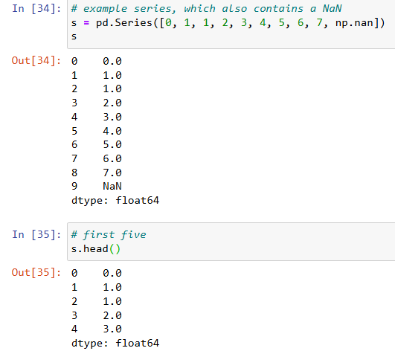
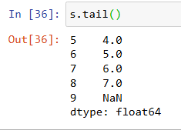
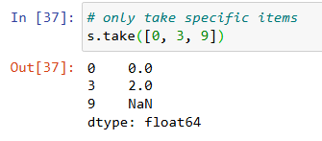
Peeking at data with heads, tails, and take
pandas provides the .head() and .tail() methods to examine just the first few, or last, records in a Series.
By default, these return the first or last five rows, respectively, but you can use the n parameter or just pass an integer to specify the number of rows

Slide 18
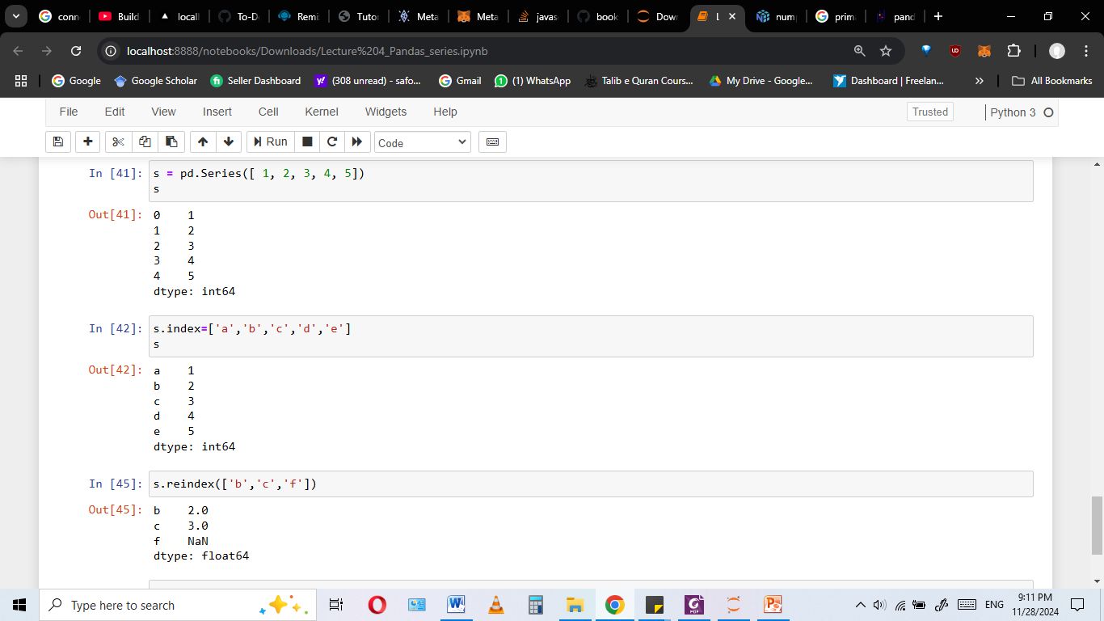
Re-indexing a Series
Re-indexing in pandas is a process that makes the data in a Series or DataFrame match a given set of labels.

